Slide 1
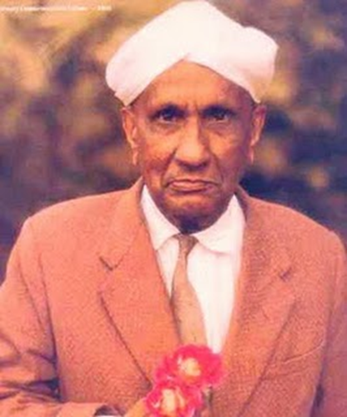
C.V.Raman The Nobel laureate in physics
HDPC Biography Presentation
BY
Shreerang Mhatre
111056
Div- 11

Slide 2
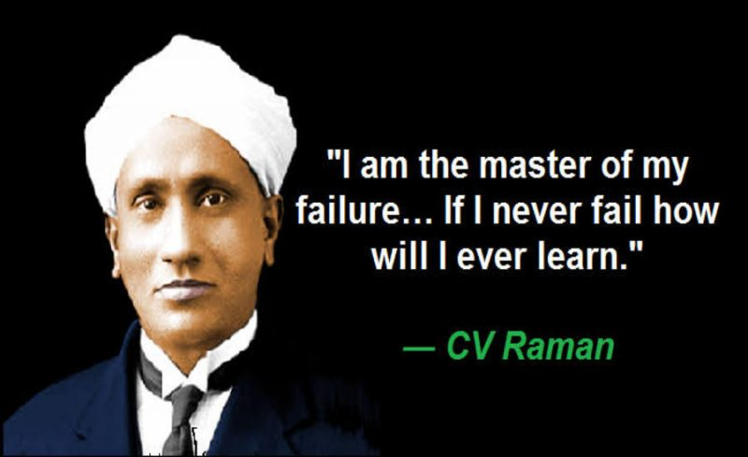
The quote by the great C.V.Raman
“I am the master of my failure….If I never fail how will I ever learn”
Inspired me for the biography presentation. Our failures are just a step prior to our success and we should indeed learn from it and refine ourselves.

Slide 3


Childhood & Family details….
Story begins in a village near Tiruchirapalli
Born on 8 Nov.1888
Second child of R.Chandrasekhara Iyer & Parvathi Ammal
Family moved to Vishakhapatnam when he was 4 years old.
Father was a lecturer in Mrs.A.V.Narasimha Rao College,Visakhapatanam.

Slide 4
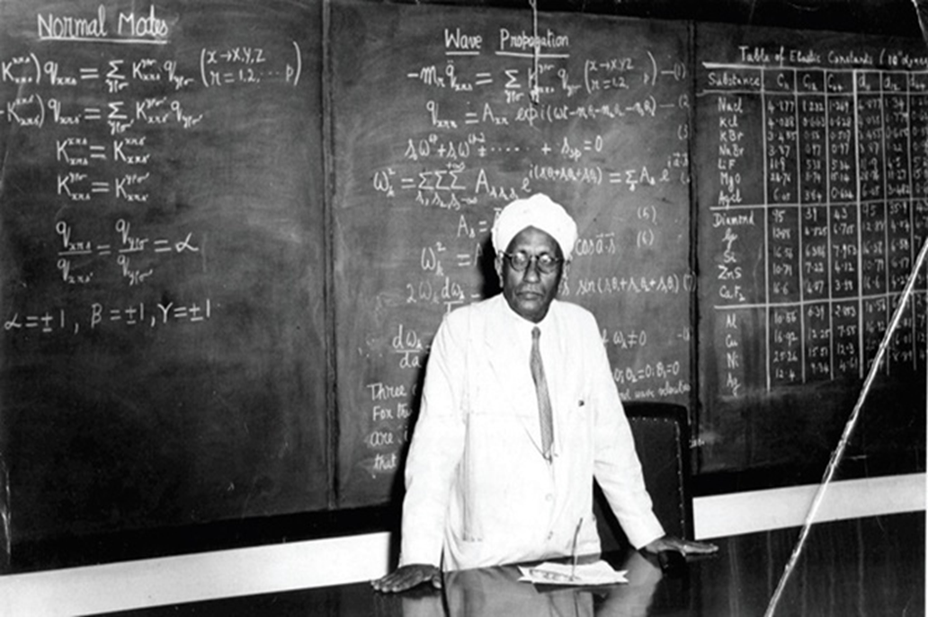
Education:
Matricalculation in 1900.(Age of 11years)
B.A First rank at Presidency college in 1904.
(Gold Medal)
First Research paper in 1906
M.A :IRS Examination in 1907(First rank in both)
British Govt. Service as AAG in 1907-1917
Palit Professor ,Calcutta University in July 1917
Raman spotted IACS(Indian Association for the Cultivation of Science) sign
board and joined. Performed the legendary experiments on light

Slide 5

Raman’s Research with waves, sound and acoustics
He was fascinated by waves and sound, and seem to have carried in his mind the memory of reading Helmholtz’s book in his school days.
He was decisive to study musical instruments.
Explained the working of Ektara
He continued his research on acoustics
Besides the violin, he studied the Veena,
Tambura, Mridangam, Tabla and others…
EKTARA

Slide 6
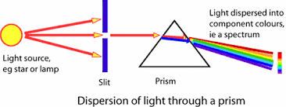
University Congress at Oxford
In 1921 he was given honorary doctorate from Calcutta University
Went overseas for the first time
Visit to University Congress at Oxford
During his voyage back to India he spent hours watching the sea from the deck of his ship. Struck by its colour
Raman’s discovery….
Water molecule could scatter light just like air molecules
His thought was a radical in those days.
In 1922 he wrote a brilliant essay ‘The Molecular Diffraction of Light’
He said light may exist in quanta, that is, as mass less particles of energy.
Discovery of the Compton effect in 1923
Raman’s hunch was proved right
K.R.Ramanathan spotted the phenomenon
They named the phenomenon as ‘feeble fluorescence’.

Slide 7
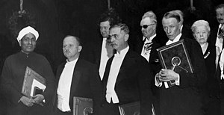
Raman @ Nobel
Raman effect took his team 4 more years
They were confident in 1927
Discovery on 28th February….
The famous Raman effect….the light can undergo a
scattering through a liquid resulting in a change in its frequency….
The date is celebrated as National Science Day
Booked tickets to Europe
He had to wait 2 years
Received Nobel Prize for Physics in 1930

Slide 8
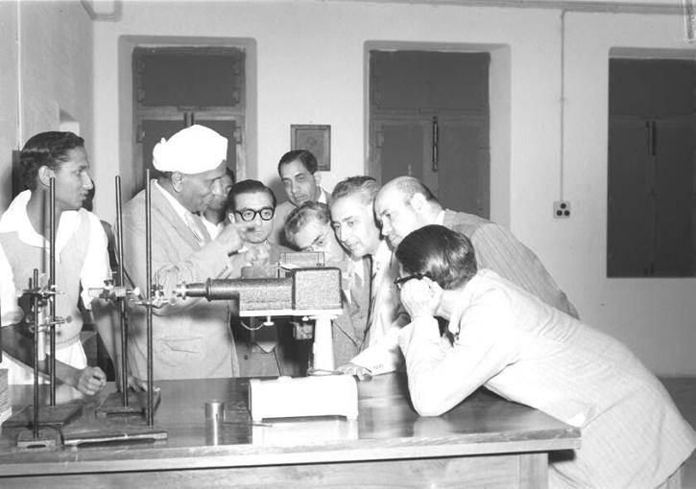
Important Contributions of Raman
Blue Colour of Sea Water(1921)
Discovery of Raman Effect(1928)
Raman Nath Theory (1934-1936)
Studies on Brillouin Scattering(1933-1940)
Discovery of the Soft Mode(1938-1940)
Other contributions: Optical and Magnetic anisotropy,
Acoustics and Indian Classical Music, Crystal Dynamics, Philosophy
of Cpolar and Vision

Slide 9
Awards
In 1912, Raman received the Curzon Research Award
In 1913, he received the Woodburn Research Medal
In 1928, he received the Matteucci Medal from the Accademia Nazionale delle Scienze in Rome.
In 1930, he won the Nobel Prize In Physics "for his work on the scattering of light and for the discovery of the effect named after him.“
In 1930, he received the Hughes Medal of the Royal Society.
In 1941, he was awarded the Franklin Medal by the Franklin Institute in Philadelphia.
In 1954, he was awarded the Bharat Ratna
In 1957, he was awarded the Lenin Peace Prize.

Slide 10
Conclusion and Learnings:
No person is perfect unless he hones his/her personality from the experiences of failures. Every man in the world is just a dupe of another by birth. What makes him as an individual is his deeds and achievements carried out in life. His experiences solely speak who he is as a person and what sense he makes to this world as well. CV Raman is the best epitome of this where he planted himself strong enough to inspire people with his deep understanding of life.
Being a laureate of Nobel Prize for Physics, CV Raman has contributed a paramount to the Science field. Alongside, his perspective and ideologies on life and success make him a great human to look up. His numerous selfless thoughts witness him as a prominent scientist, a successor and an inspirer.

Slide 11
References:
https://en.wikipedia.org/wiki/C._V._Raman
https://www.nobelprize.org/prizes/physics/1930/raman/biographical/
https://www.britannica.com/biography/C-V-Raman
https://www.newscientist.com/people/c-v-raman/
https://www.iloveindia.com/indian-heroes/cv-raman.html

Slide 12
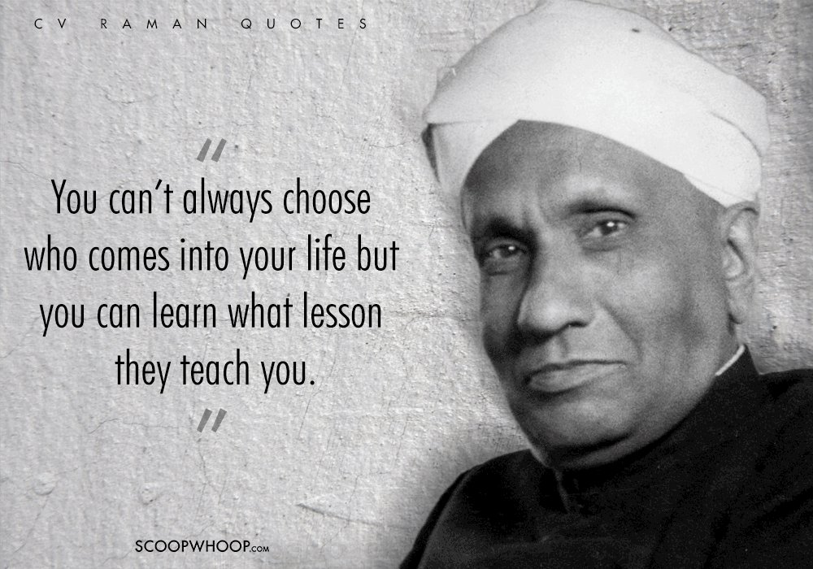
Thankyou

